Slide 1

Data Preprocessing and visualization p2

Slide 2
Agenda
Handling the OutLiers
Feature Transformation
Handling Imbalanced Dataset
Data Leakage
Adult Dataset Case Study

Slide 3


Slide 4
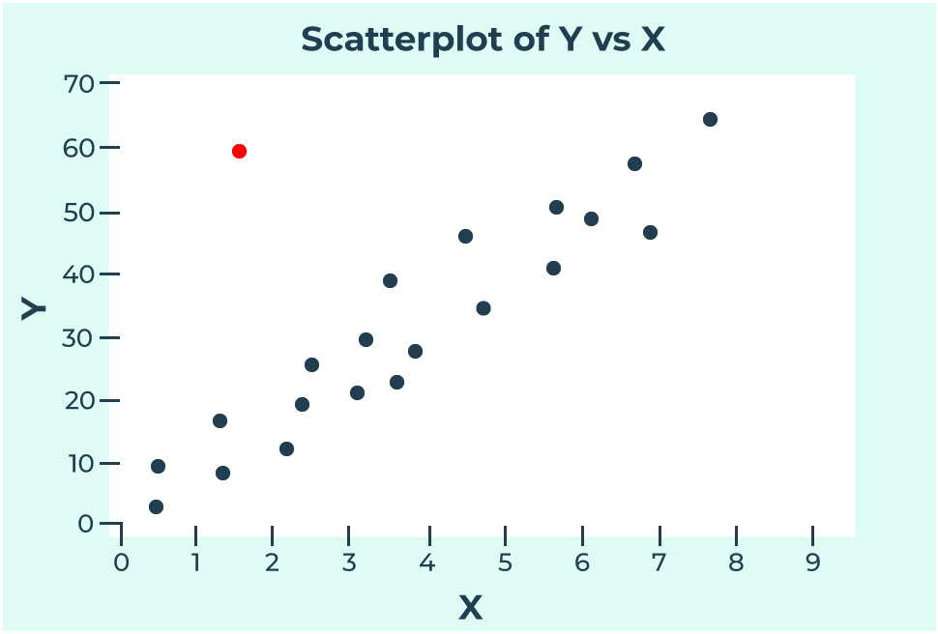

Slide 5
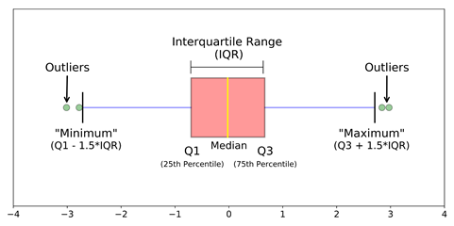

Slide 6
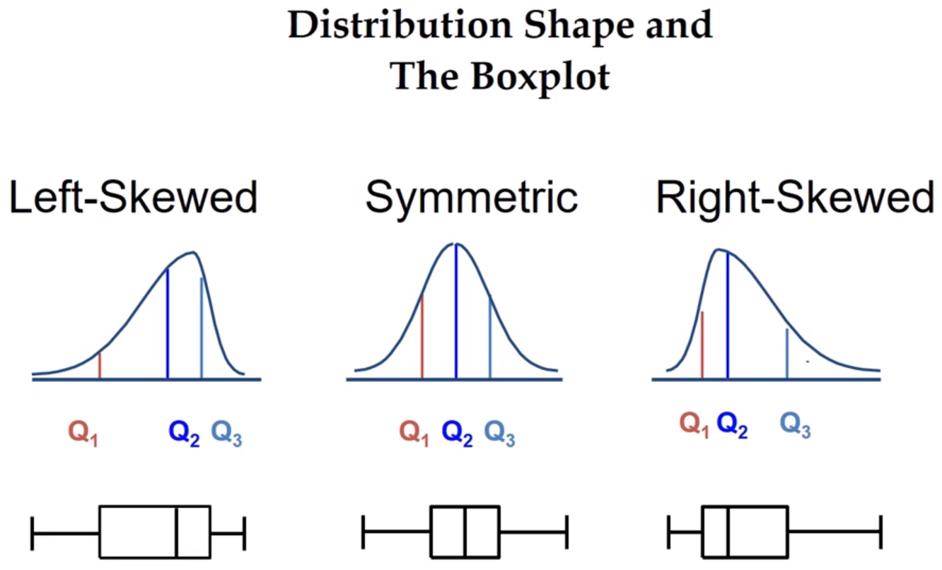

Slide 7
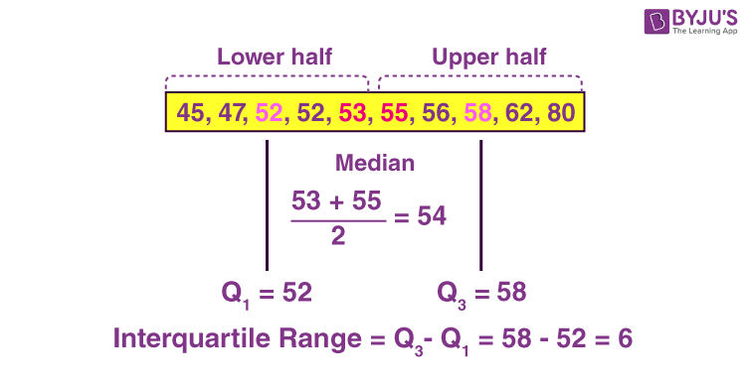

Slide 8
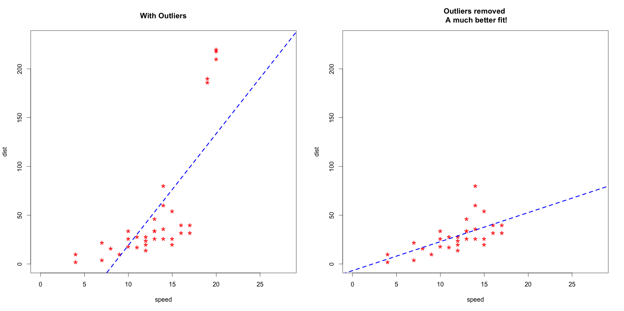

Slide 9
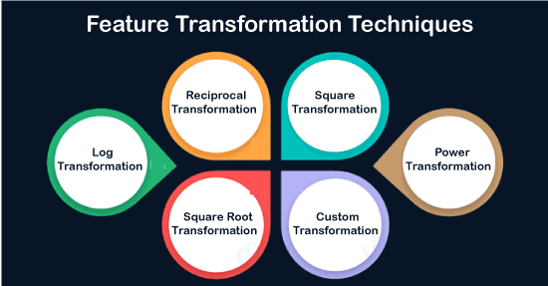

Slide 10
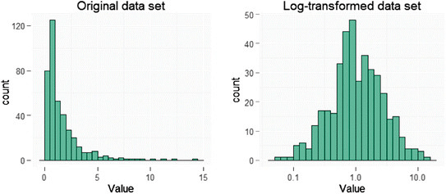

Slide 11
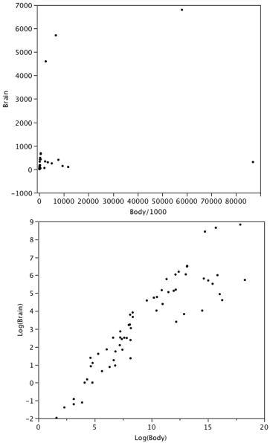

Slide 12
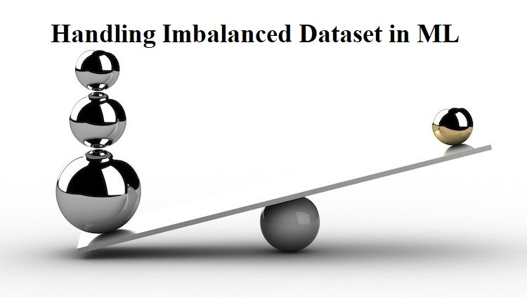

Slide 13


Slide 14


Slide 15
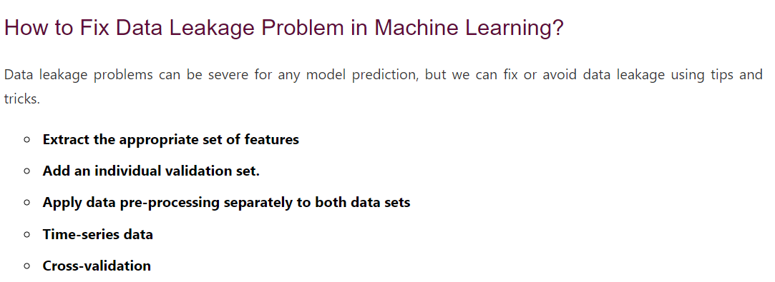

Slide 16


Slide 17
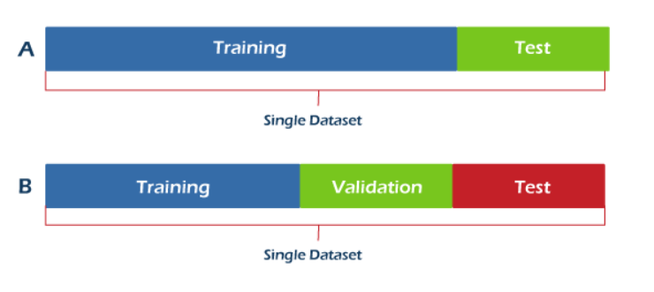

Slide 18
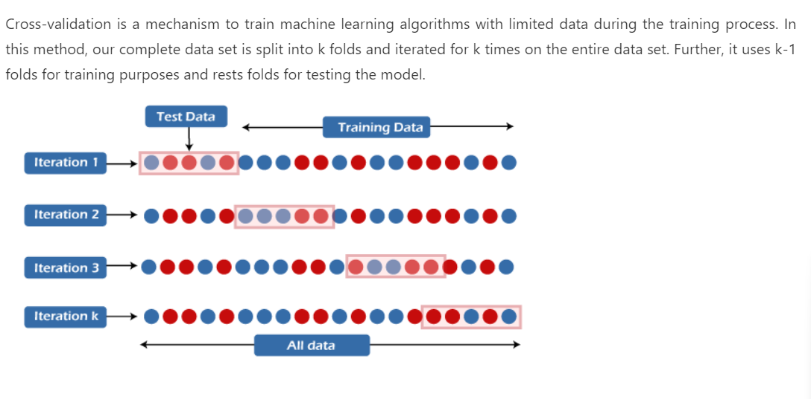

Slide 19
